Slide 1
Day 3. Graphs, Charts
Prepared by:
Alexander De Los Reyes
05 April 2019

Slide 2
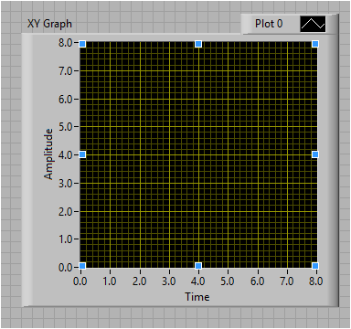
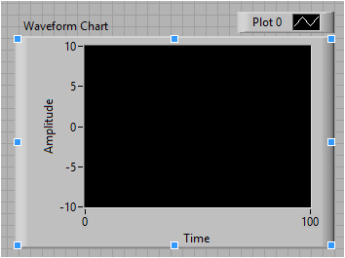
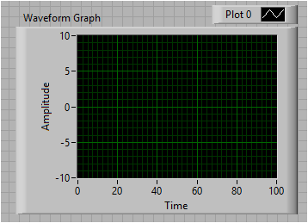


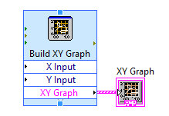
Waveform Graph, waveform chart, and XY Graph

Slide 3
XY Graph
As its name suggests, the XY Graph is used to display relationships.
The XY Graph control receives array elements as inputs.

Slide 4
Waveform Graph
A Waveform Graph accepts arrays of data in various forms, e.g. array, waveform, or dynamic data.
It then plots all the received points at once.
It does not accept single point values.
When an array of points is wired to a waveform graph, it assumes the points are equally spaced out.
By default, the starting X value and step size (t0 and dt) are 0 and 1 respectively.
This can be changed in the properties of the graph or using property nodes.
https://knowledge.ni.com/KnowledgeArticleDetails?id=kA00Z000000P9zsSAC&l=en-PH

Slide 5
Waveform Chart
A Waveform Chart remembers and displays a certain number of points by storing them in a buffer.
When the buffer gets full, the chart starts overwriting the oldest points with new ones.
As the data points become available, the Waveform Chart displays received data in addition to already existing points.
You can write single or multiple data points to it at once.
If we wire an array of points to the chart, it will append those points to the existing ones.
You can display multiple plots on the same chart by wiring in a cluster of points or a 2D array containing waveform or dynamic data for each plot.
For example, if you wire in a cluster of three points, one point will be added to each of the three plots. Similar to a real-world strip chart
https://knowledge.ni.com/KnowledgeArticleDetails?id=kA00Z000000P9zsSAC&l=en-PH

Slide 6
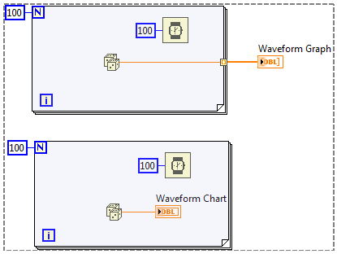
Waveform Graph vs Waveform Chart
https://knowledge.ni.com/KnowledgeArticleDetails?id=kA00Z000000P9zsSAC&l=en-PH

